Slide 1



AUTONOMOUS SHIPPING Sprint 3
Jasper Vlaar, Jelte Molenaar, Job Vink, Michiel van Soest en Martin de Rijke

Slide 2
Topics
Innovation expo
Demo
Opportunities
Research Paper
Structure
Responsibilities

Slide 3
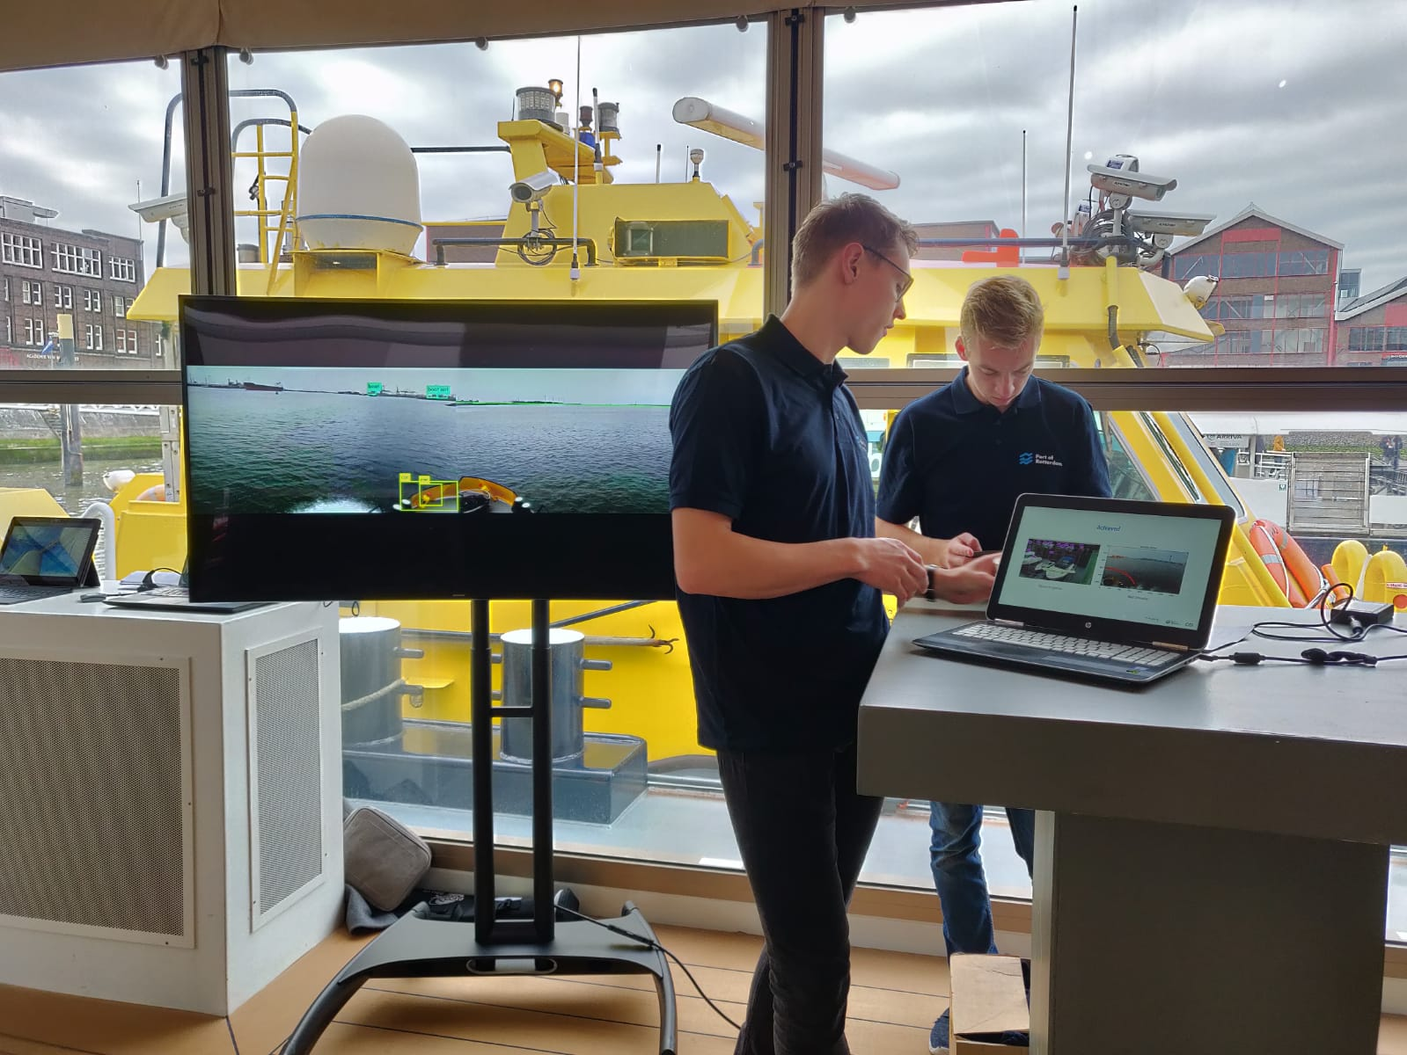
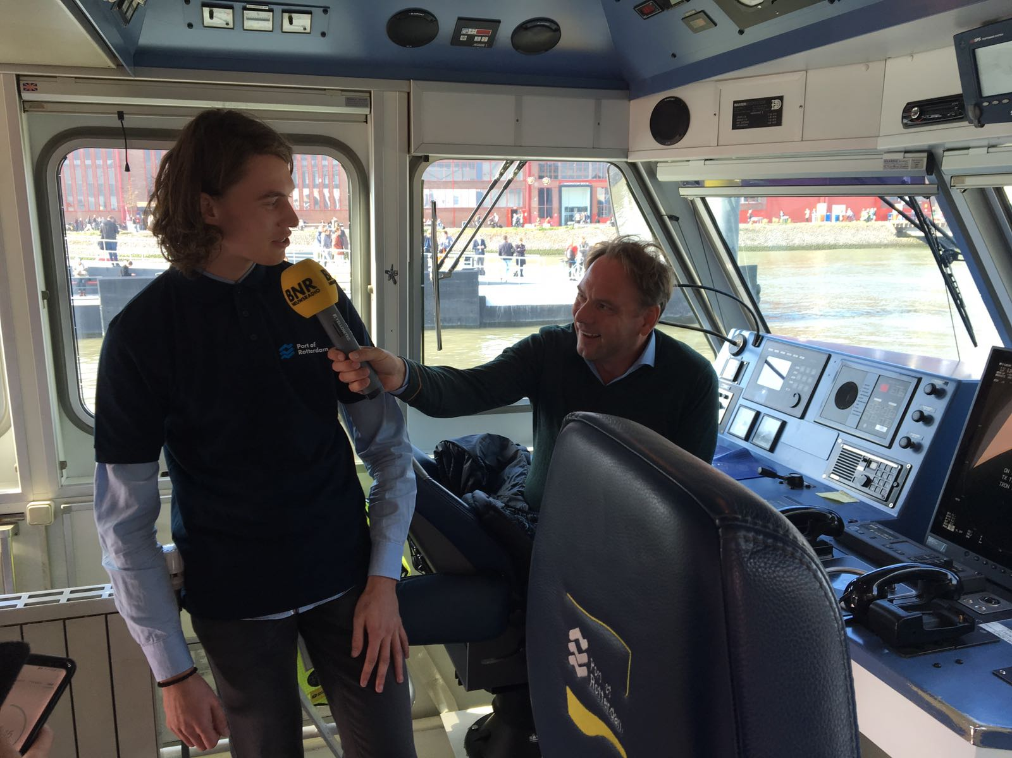
Innovation Expo

Slide 4
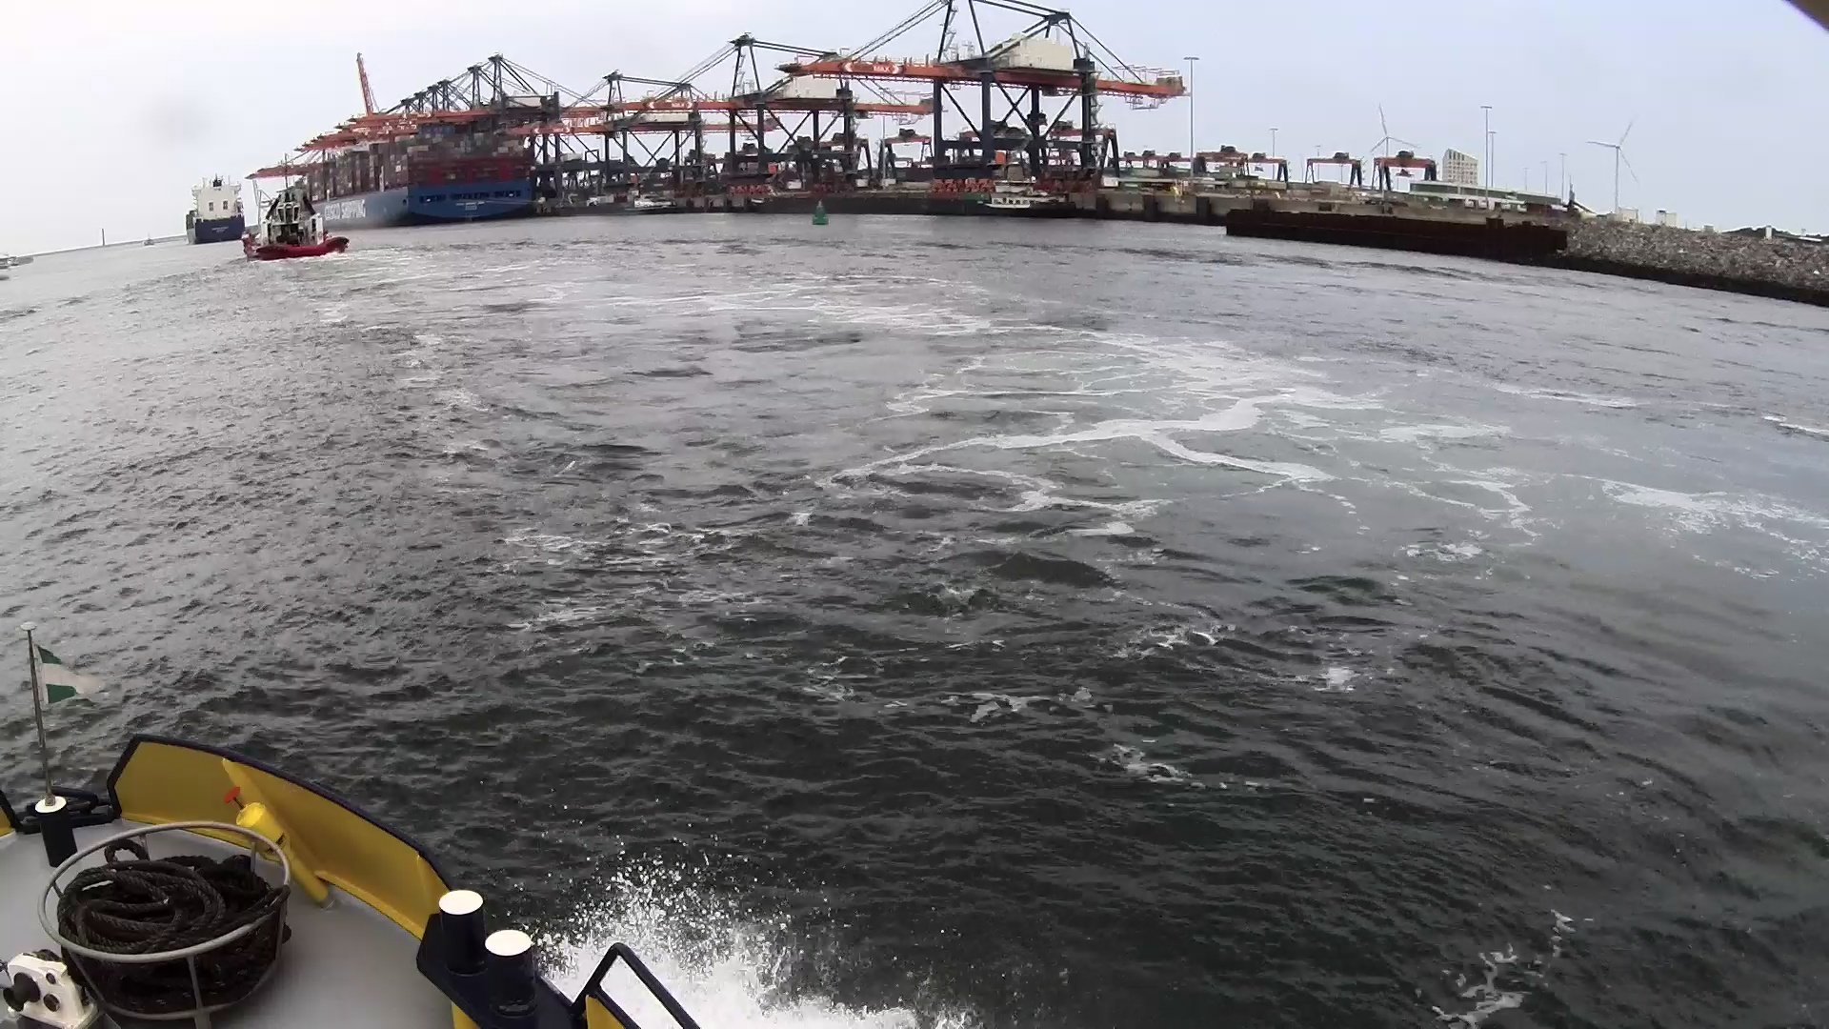
Research Paper
Original

Slide 5
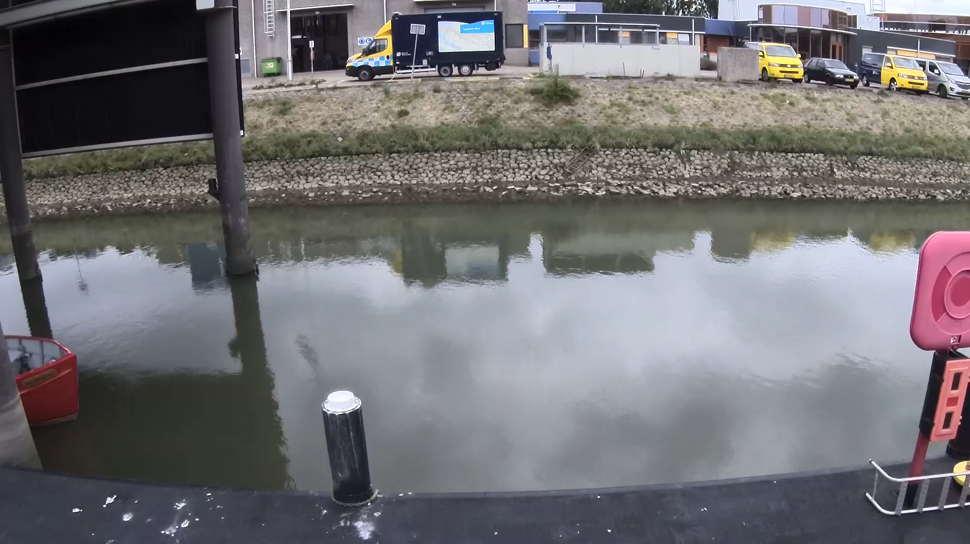
Calibration camera’s Fisheye
Undistorted images
Checkerboard → Algorithm → Parameters

Slide 6
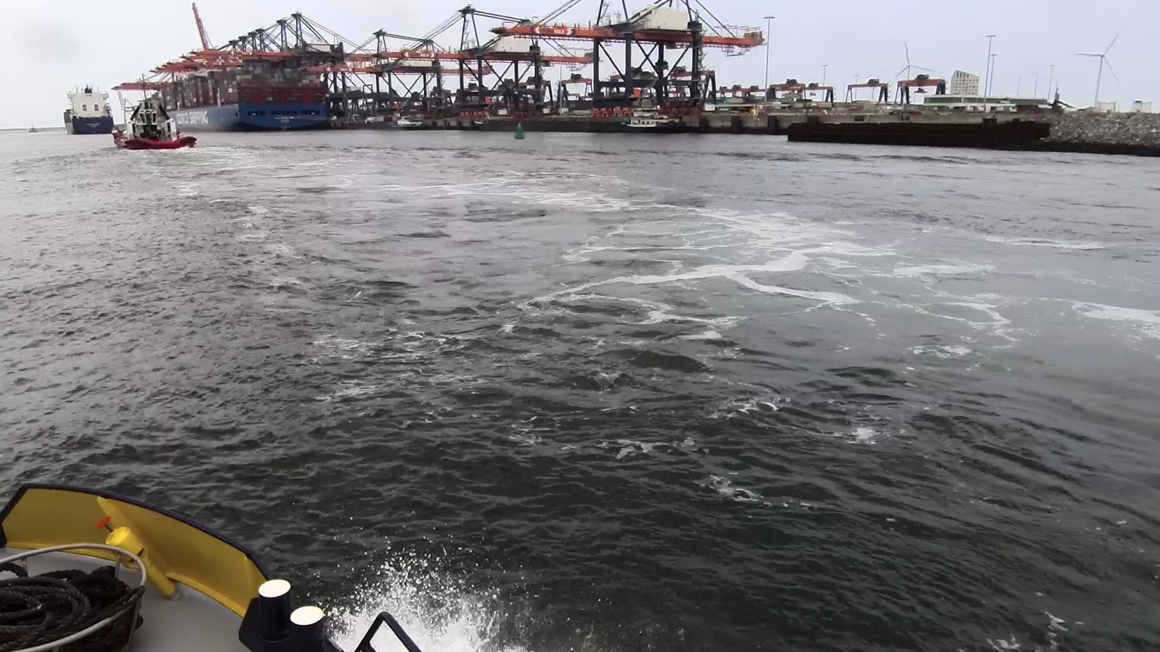
Calibration camera’s Results
Original
Undistort image

Slide 7
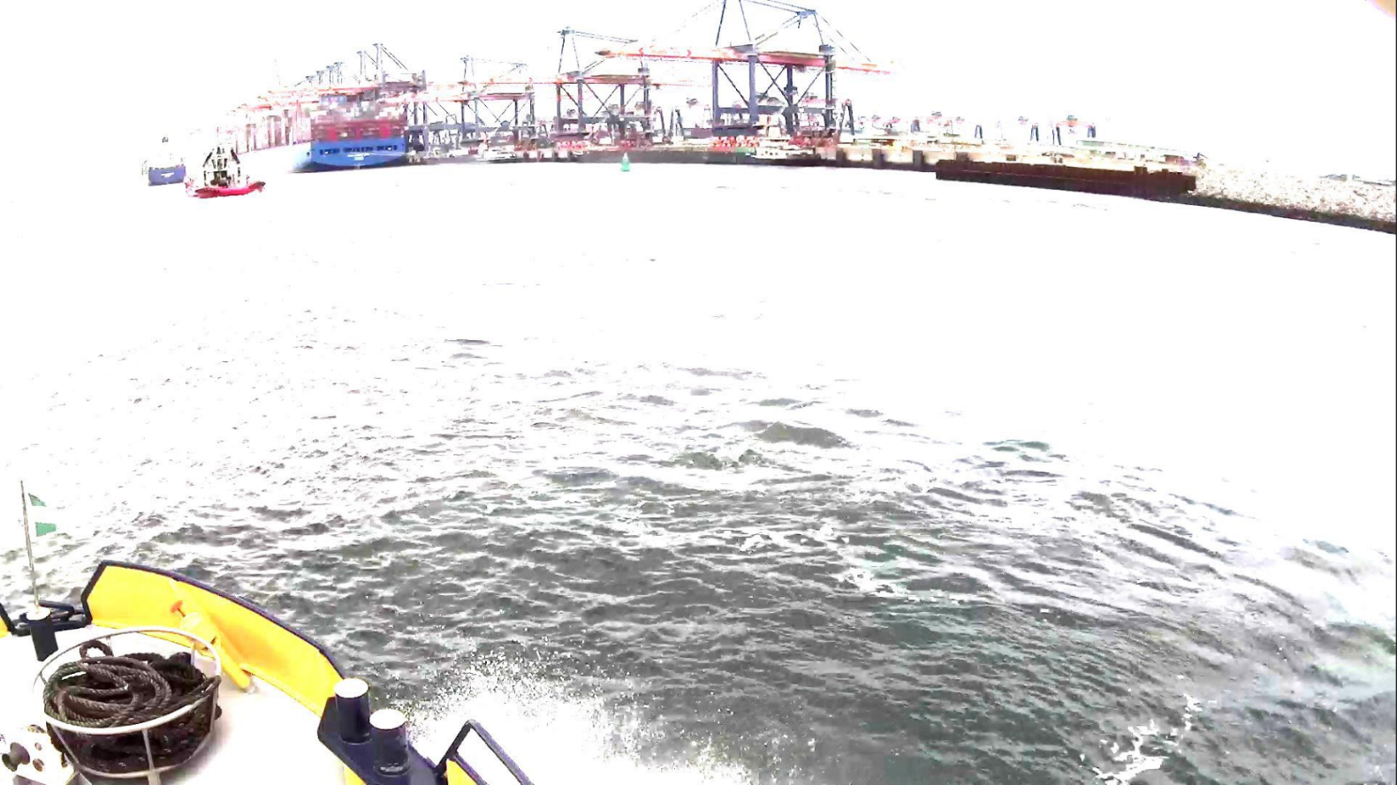
Calibration camera’s Results
Editing
Original
Brightness

Slide 8
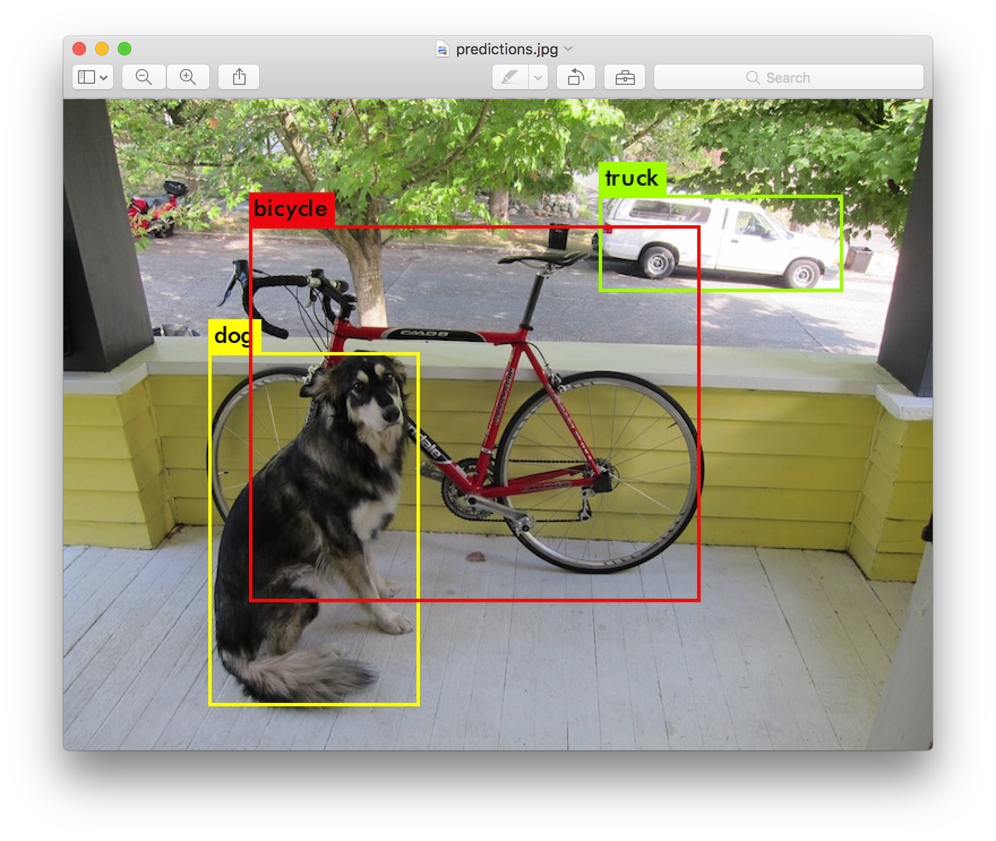
Object recognition Installation
Achieved
Machine learning (Neural network)
Yolov3(Darknet)
Coco library
Bottlenecks/To Do:
OpenCV (server)
Optimalisation
Training
Ship Libary

Slide 9
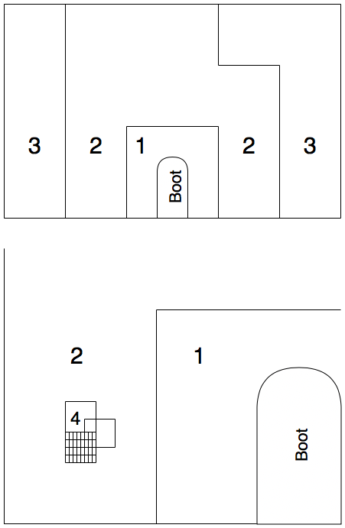
Water/land Detection Approach
Recap of last week

Slide 10
Live Demo Version 0.1

